Slide 2
THE GREATEST LESSONS OF
JESUS RESURRECTION.
John 20:19-31
Ptr. Rod Lago

Slide 3
The Book of Gospels displays his own story about the Resurrection of Jesus Christ.
MATTHEW – display his own version of Christ Resurrection through a specific story from the beginning of violent earthquake, then the devised plan of the chief priest, down to the assurance of His Promises.
MARK – only in his book appeared the word “rebuked” to all eleven disciples after His resurrection for their lack of faith, and stubbornness.

Slide 4
The Book of Gospels displays his own story about the Resurrection of Jesus Christ.
LUKE – telling a short story of the disciples who was going to a village called “EMMAUS” down to Jerusalem sharing the whole experience of Christ death and end with confirmation of His promises in the book of Acts.
JOHN – was a relational resurrection due to some unique presentation and testimonies among the gospels. It was a revelation of faith and true doctrine that JESUS is the only begotten SON OF GOD.

Slide 5
Problem in Christ Resurrection:
The early disciples of Christ refute the doctrine of the Pharisees who did not believe to the “DOCTRINE OF RESURRECTION”
The lies of the Chief priest, Elders, and Soldiers who testifies to all the Jews that the disciples came during the night and stole the body of Jesus while they are asleep.

Slide 6
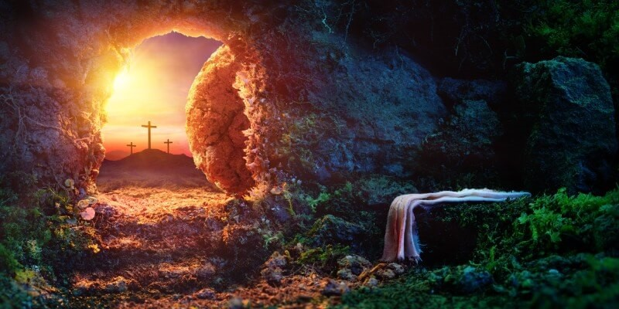

The Witnesses:
Mary Magdalene – Matthew 28:1-9
The Roman Soldier Guards – Matthew 28:11
2 Disciples – Mark 16:12-13
The 12 Apostles – Matthew 28:16-20, Mark 16:14-18, Luke 24:36-53, John 21:1-14
120 Disciples – Acts 1:15
More than 500 Disciples – 1 Corinthians 15:6

Slide 7
What are the Greatest lessons of Jesus Resurrection???

Slide 8
IT IS YOUR DELIVERANCE FROM THE PAST.
Colossians 2:12-13
GOD deliver us from our old sinful life, then when Jesus was raised to life again we were raised with Him as a New Creation.

Slide 9
Purpose of Deliverance from our Past?
To Give us New Life. – 2 Timothy 1:9-10
To Give us New Birth. – 1 Peter 1:3
To Give us New Beginning. – 2 Corinthians 5:17

Slide 10
LIFE APPLICATION:
Christ did not only come to save the world, but He did also not only come to Heal the broken hearted, but He also came to set us free from the bondage of sin.
We are now free because Christ set us FREE!!!

Slide 11
2. IT IS YOUR
POWER
FOR THE PRESENT. –
Acts 1:8, Philippians 3:10
Because Jesus is Alive, we have now received the Power of the Spirit to live a life of Victory over sin and all Satan's attack against us.

Slide 12
This POWER gives us:
Victory over Satan. – 1 John 4:4, 5:4-5
Authority and Power over Satan. – Luke 10:17-19, Mark 16:15-18

Slide 13
LIFE APPLICATION:
If we put our lives in God’s hands and rely on His Power, nothing can stop us, nothing can defeat us, nothing can destroy us. Because the most important thing in life is Knowing Christ and Experience the Power of His Resurrection.
Romans 8:31-39 –That we are more than Conquerors in Greek word means “SUPER CONQUERORS” and “OVERWHELMING VICTORY”

Slide 14
3. IT IS YOUR
HOPE
FOR THE FUTURE.
1 Cor 15:17-23, 1 Thess 4:13-18, Titus 2:13
The Resurrection of Jesus gives us Great Hope for the Future, in His resurrection, He was opening the way for all those who would believe in Him and to follow Him.

Slide 15
LIFE APPLICATION:
The Power of Jesus Christ Resurrection was not only proved that He has the power, but it is only proved that He has All the Power and Authority both Heavens and earth.
That even death cannot hold His Divinity because the Proof of His empty tomb is the True evidence of His True Nature as GOD.

Slide 16
CONCLUSION:
“THE RESURRECTION OF OUR LORD JESUS CHRIST MEETS THE NEEDS OF LIFE.” BECAUSE…..
IT IS OUR DELIVERANCE FROM THE PAST.
IT IS OUR POWER IN THE PRESENT.
IT IS OUR HOPE FOR THE FUTURE.

